Slide 1

Welcome to DragonHacks 2018!

Slide 2

What Is New?
New DragonHacks logo
MLH is back at DragonHacks!
DragonHacks 2018 has a theme
Fire vs. Ice
This will affect the entire dynamic of the event

Slide 3
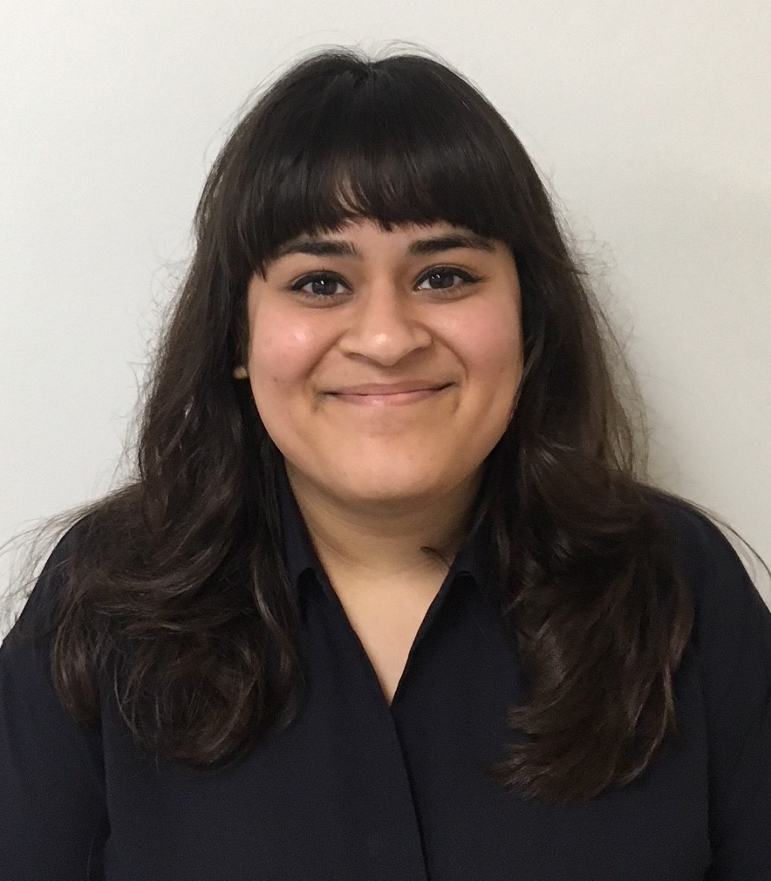
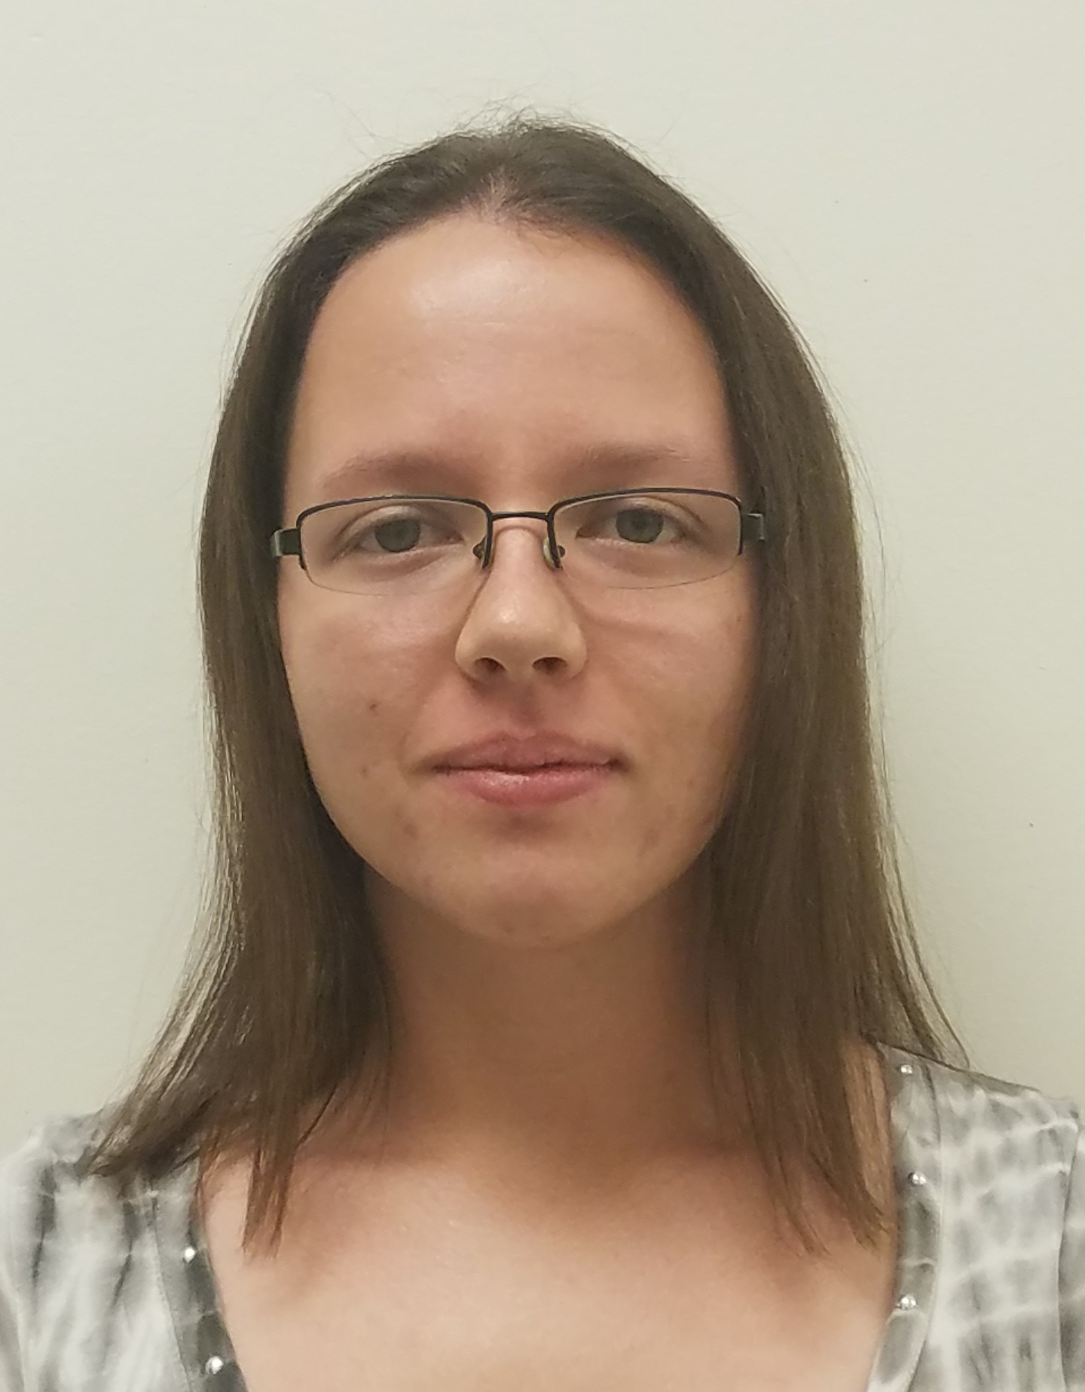
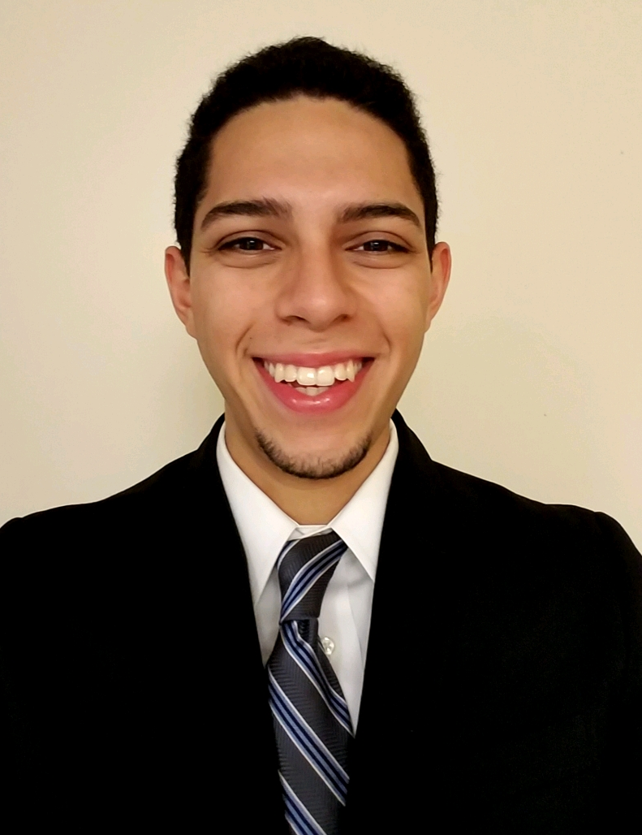
Meet The Exec. Team
Logistics Manager
Administrative Manager
Social Media Manager
Anvita Mishra
Chelsea Chapeliere
Ethan Garcia

Slide 4
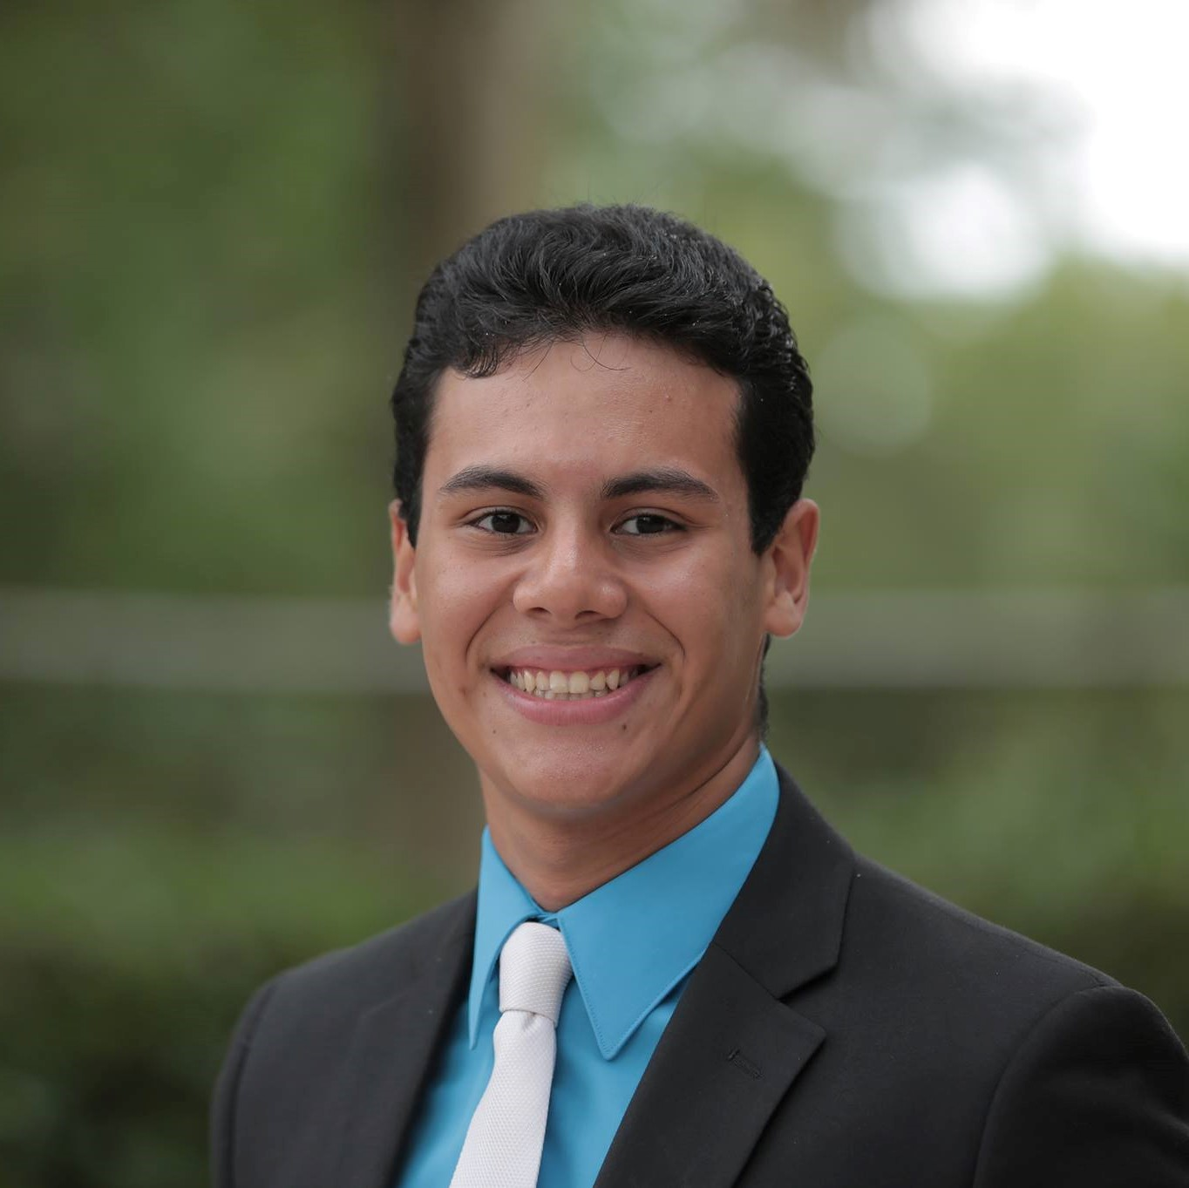

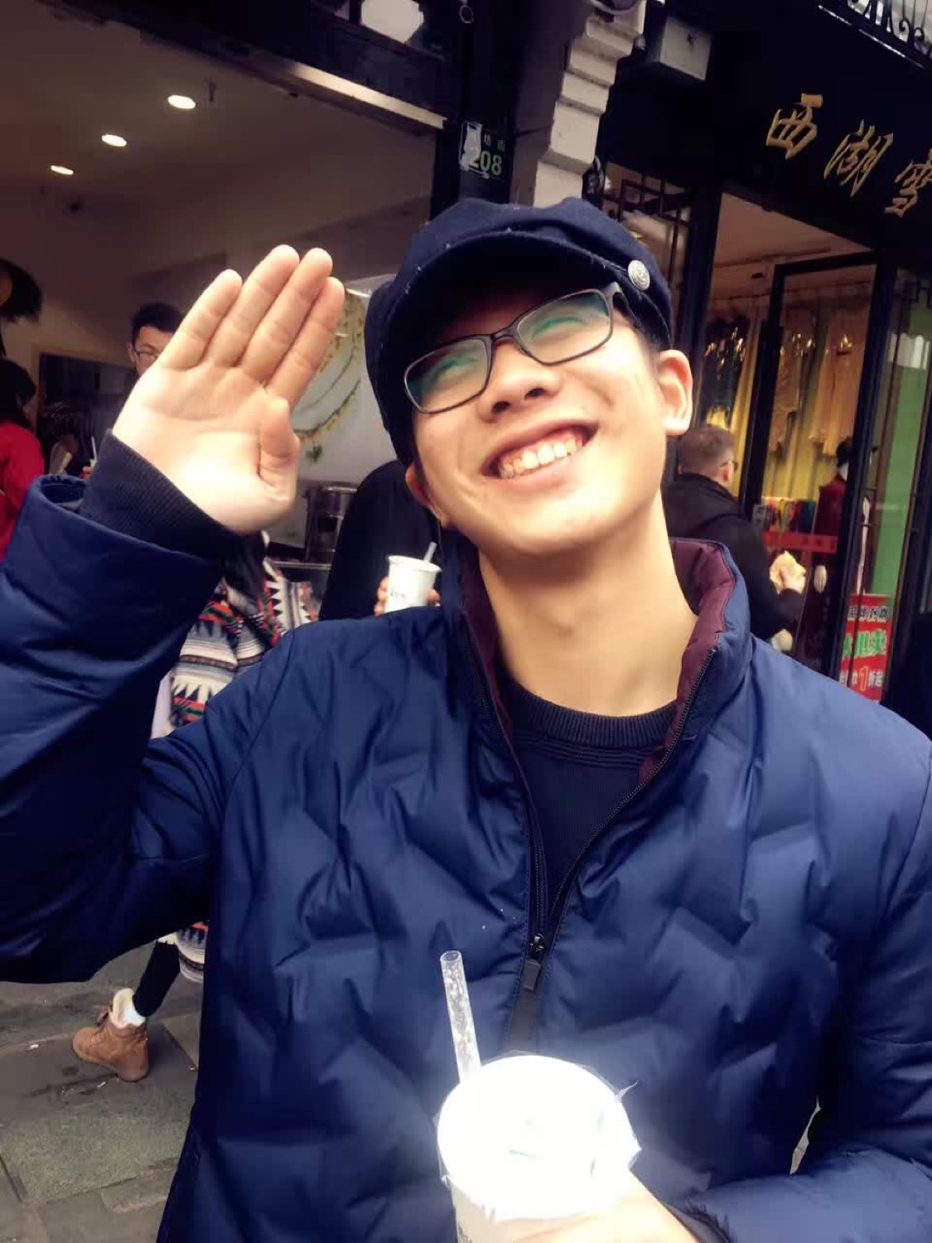
Meet The Exec. Team
Director
Co-Director
Co-Director
Alfredo Flores
Zizi Elgamal
Edward Li

Slide 5












Thank You, Sponsors!

Slide 6















Thank You, Sponsors!

Slide 8


Hello Dragon Hacks!
Jim Weber, Lutron Philadelphia Engineering Office Manager, Software Engineer
Also here:
Tomer Shemesh, Applications Software Engineer
Kevin Walton, Embedded Software Engineer
Nirav Shah, Computer Engineer
Deeksha Yogish, Embedded Software Engineer

Slide 9
Who is Lutron?
Electronics manufacturer specializing in lighting, shading, and sensors
Our founder invented the solid state dimmer (energy saving dimmer vs resistive dimmer)
…more importantly we create smart home/building devices and software systems

Slide 10

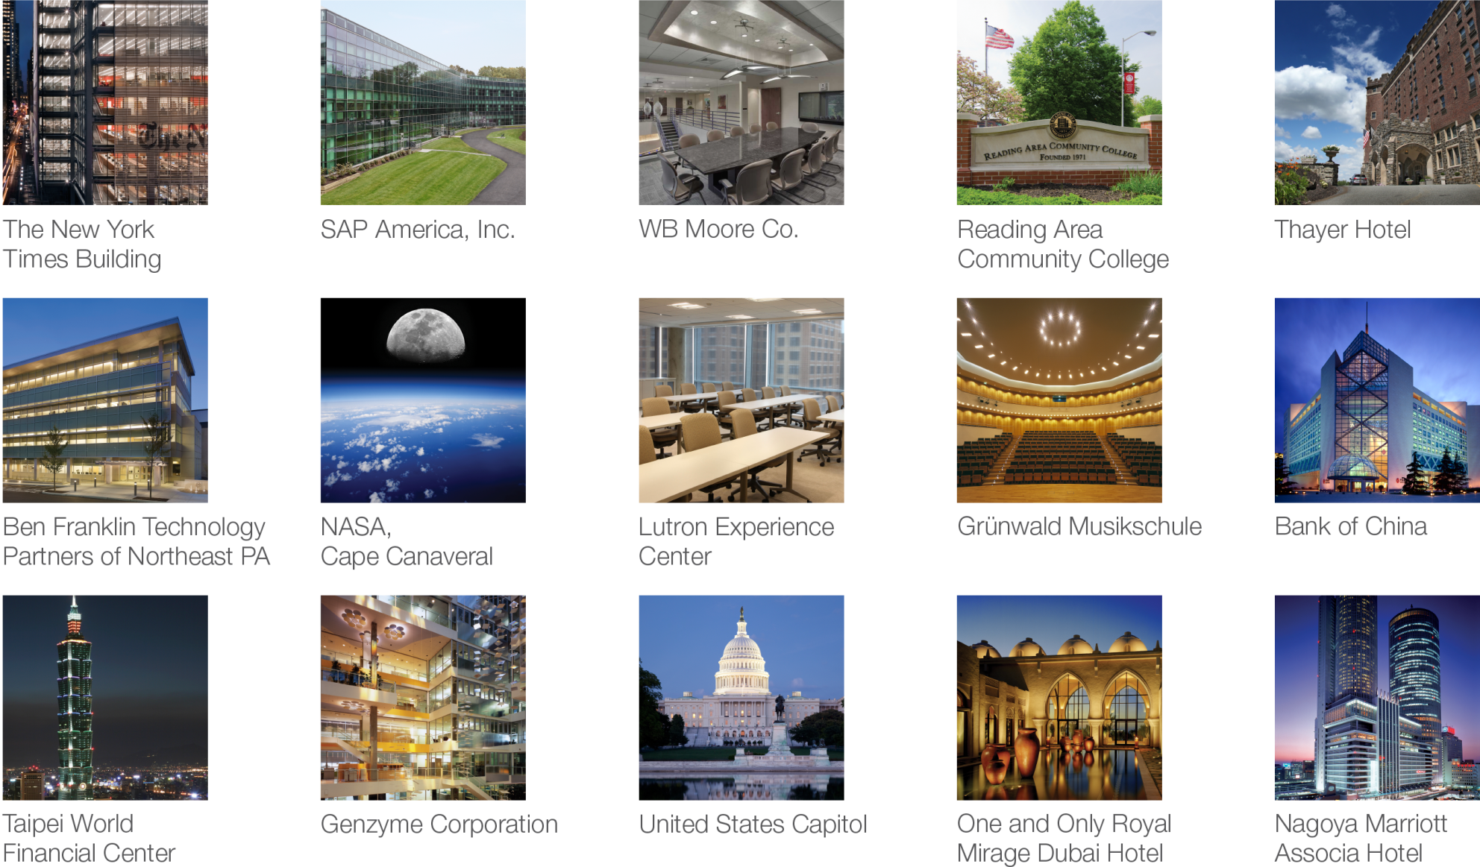

Slide 11
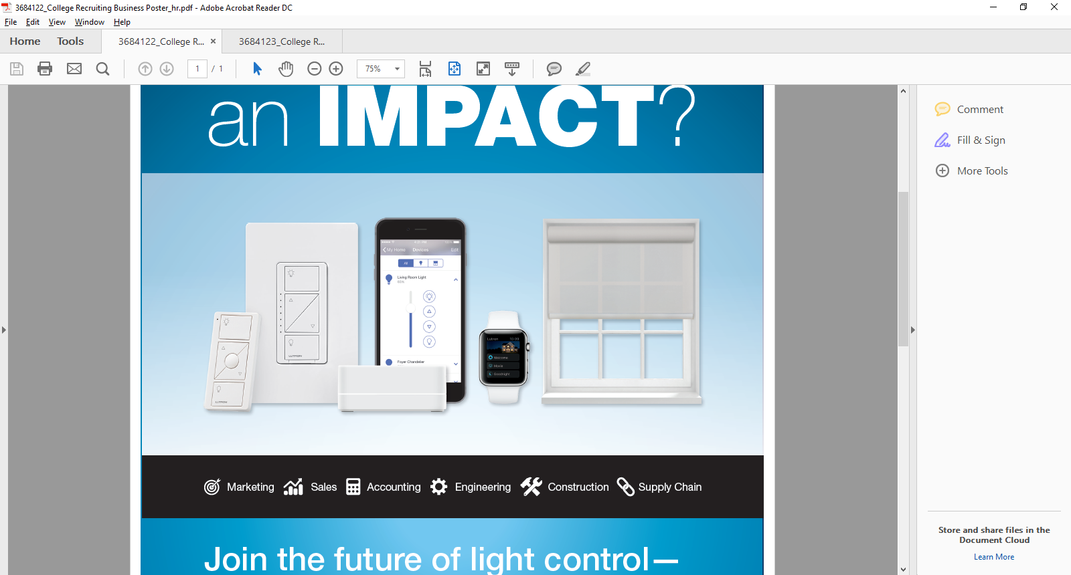
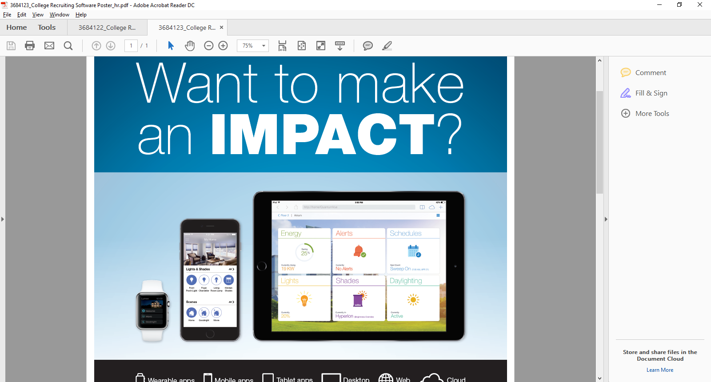
Devices (wired and wireless)
dimmers, switches, fan speed controls, motor controls (in-wall, table-top, plug-in, in fixture, module based, panel based, etc.)
smart LED drivers, smart fluorescent ballasts, embedded systems for fixture manufacturers
HVAC controllers
daylight sensors, temperature sensors, occupancy sensors, contact closure inputs
keypads, keypads, keypads
automated roller shades, draperies, venetians, honeycomb shades (wired and battery operated)
matching accessories
and much more…
Software Systems
end user mobile apps, watch apps
cloud to cloud, cloud to system integration
smart home/building system software
user account and system registration services
secure remote access communication services
system commissioning software (design and programming)

Slide 12

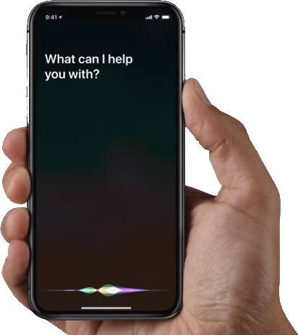
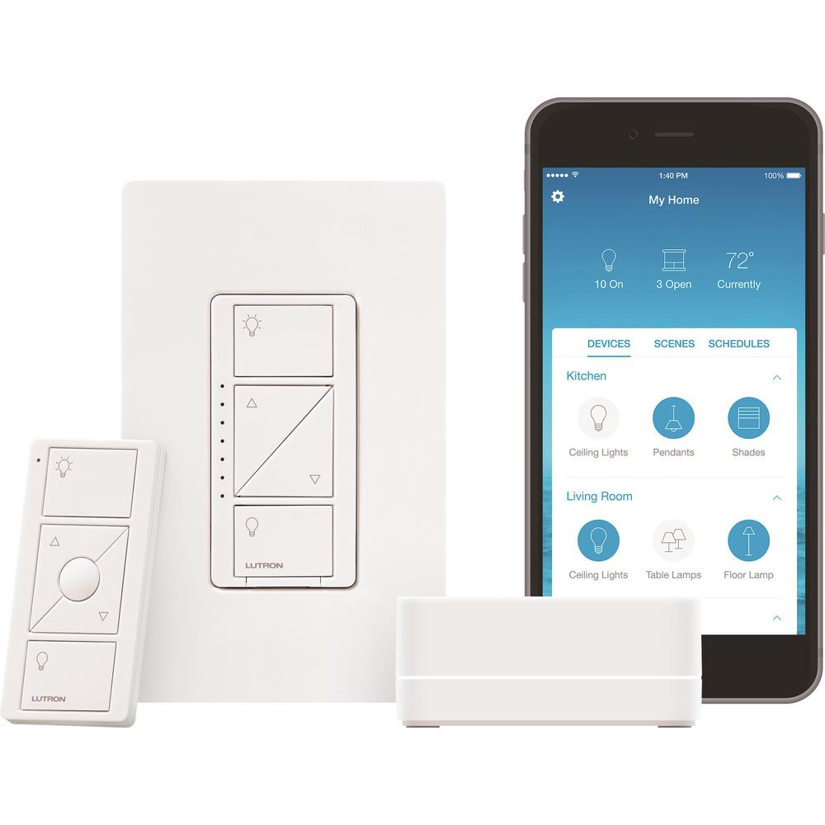

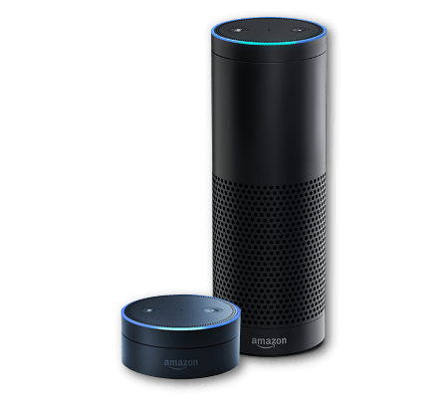



3rd Party Integrations
Alarm.com
Amazon Alexa
Apple Siri
Bang & Olufsen
Comcast
Control4
Ecobee
Elan Home Systems
Google Home
Honeywell
IFTTT
Logitech
Nest
Savant
Sonos
Smart Things

Slide 13

Where is Lutron?
Lutron is headquartered in the Lehigh Valley
Remote engineering office in Philadelphia for Applications Software Engineering

Slide 14

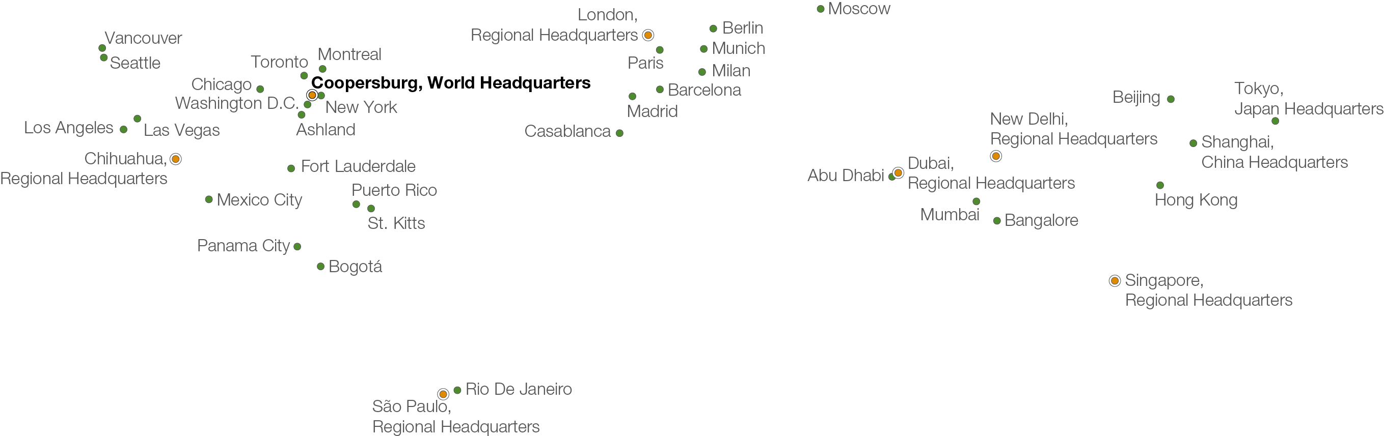

Boston
Philadelphia

Slide 15
DragonHacks Slack: @Lutron
Twitter: @lutronjobs
Website: http://careers.lutron.com

Slide 16

TMNA Services
Who We Are and What We Do!

Slide 17
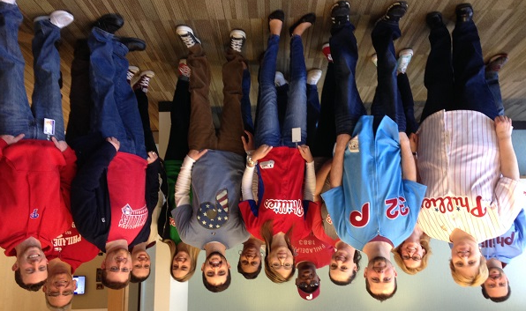
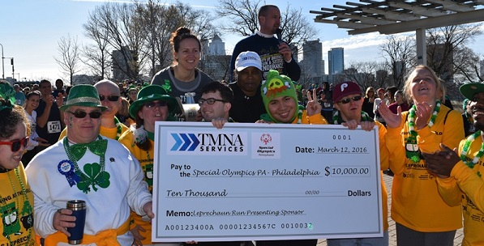
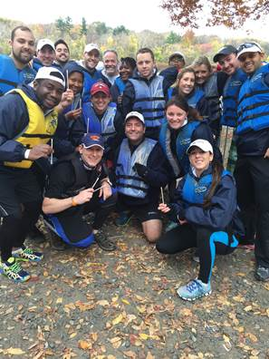

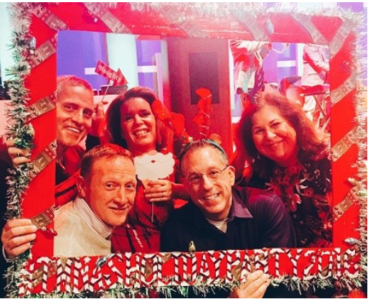
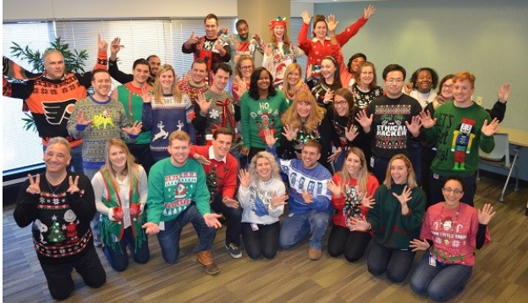
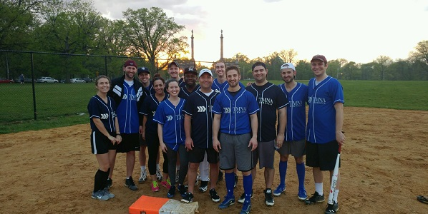
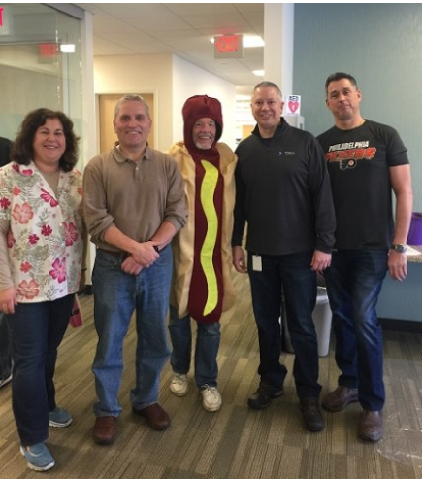

Slide 18
Who Are We?
Shared Services Organization
At TMNAS, we strive to provide superior professional services which support the business and governance needs of our valued customers.
Primary Customers
Tokio Marine America (TMA)
Philadelphia Insurance Companies (PHLY)
First Insurance Company of Hawaii (FICOH)

Slide 19
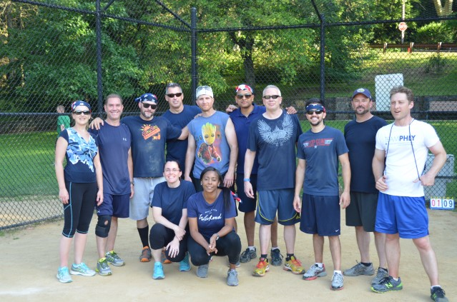
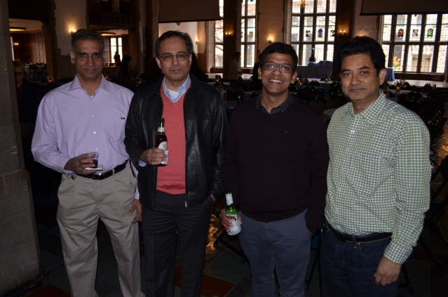
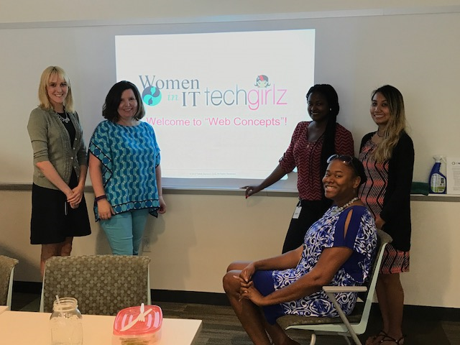
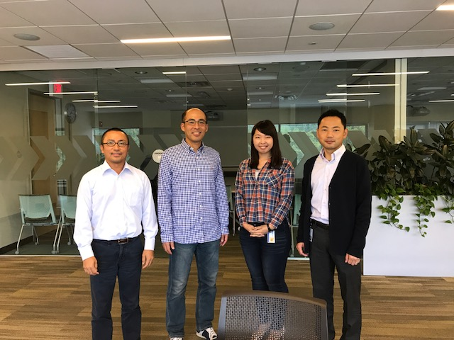
TMNAS Information Technology Team Welcomes You!

Slide 20

Who are we and where are we going?
Our mission - To design, build or acquire, deliver, and sustain high-quality technology solutions and services which align with Group Company objectives for revenue growth, enhanced customer service, and efficient expense management.
We are Insurance Technology
Shared Services. Shared Vision.
Our Strategy - We focus on both process and service maturity (delivery & governance) to provide quality services to the Group Companies.

Slide 21
IT is more than tickets and laptops…
Our goal is to “be the business.”
We serve our customers and the employees of TMNAS by:
Building customer relationships
Enhancing business capabilities
Developing and improving the quality of business applications
Maintaining and securing all of our business data
Helping our users make informed decisions with advanced analytics and timely reports
Maintaining our infrastructure
…and keeping laptops updated and responding to tickets

Slide 22
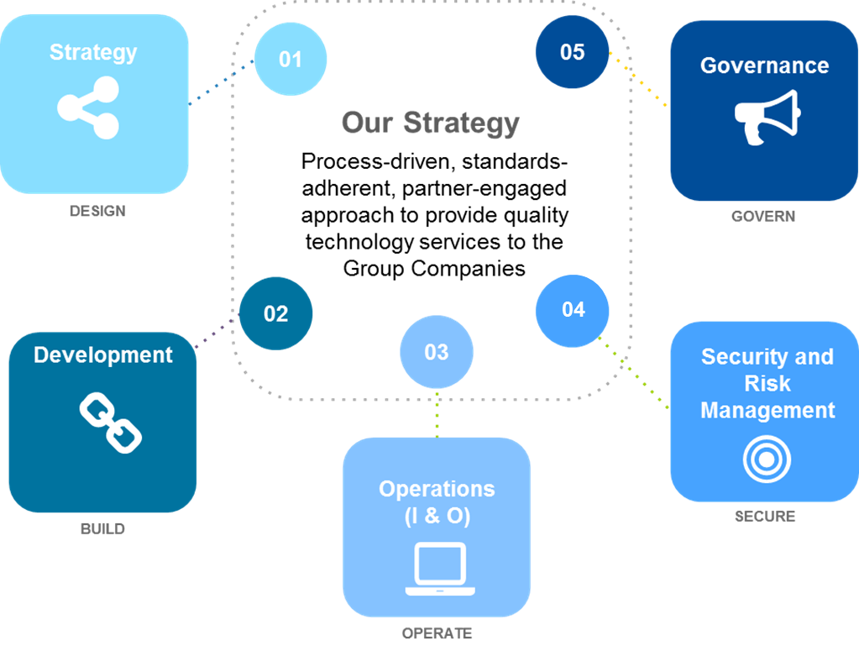
We Are Structured Around 5 Domains

Slide 23
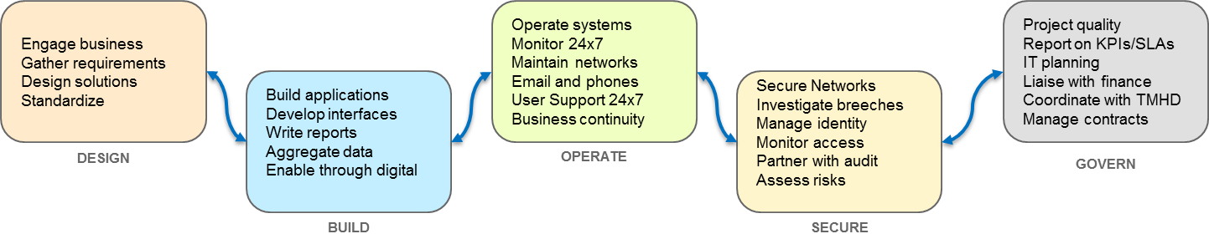
What we do, in a nutshell

Slide 24
Technology We Are Using!
ServiceNow
Sharepoint
.Net
Java
Business Intelligence Tools (Business Objects)
Microsoft Exchange
Active Directory
SCCM
Cisco Tandberg
SSIS, SSAS, SSMS, SSRS
Cognos
SQL Server
IdentityIQ
Entrust
WebEx
VMWare
PowerBI

Slide 25
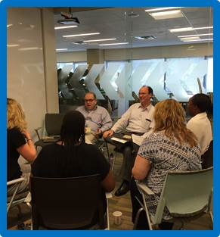
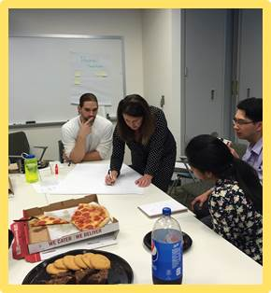
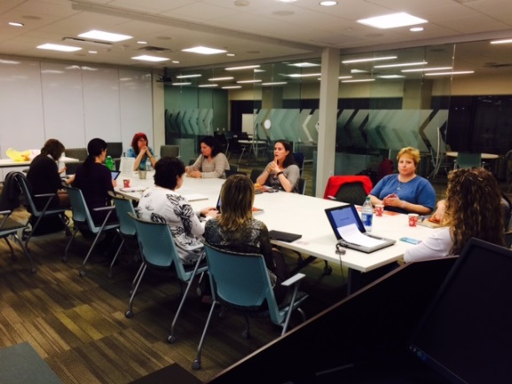
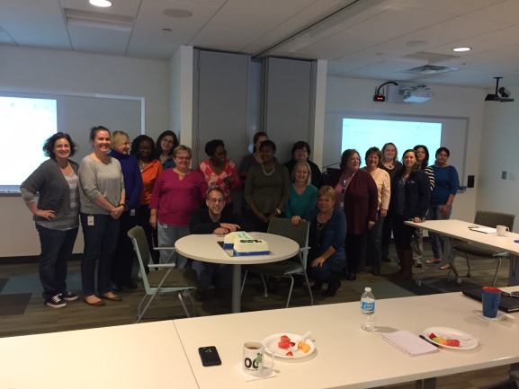
A great team!
IT Staff Action Committee
Team members representing broad experience across TMNAS IT broken up into four sub-communities:
Management Policies
Training and Development
Process and Structure
Communication
Women of IT
Connects women in IT and those who support them
On-line community (Jive Thread – Women of IT Space)
Monthly Gatherings
Spotlight Series featuring Guest Speakers
Networking
Notes:
Staff Action Committee:
A feedback loop and connection between leadership and the teams they support is important. The IT Staff Action Committee serves as an accountability partner to the SVP & CIO, and to his leadership team.
Women of One IT:
A group connecting women in IT and those that support them by embracing opportunities to build professional relationships that strengthen the work environment and promote opportunities to interact and learn from IT Leadership.

Slide 26
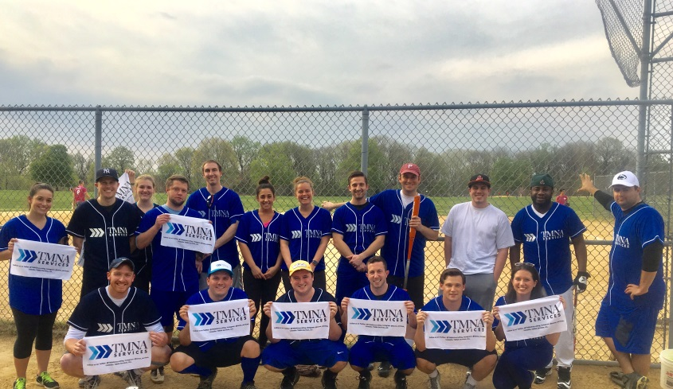
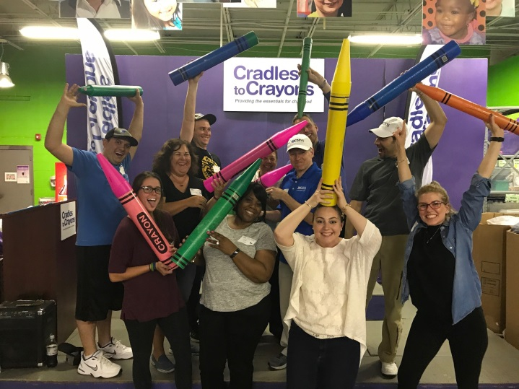

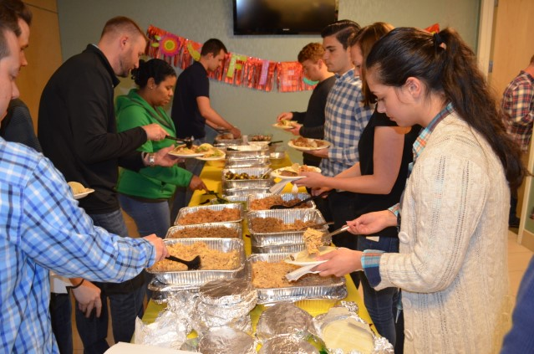
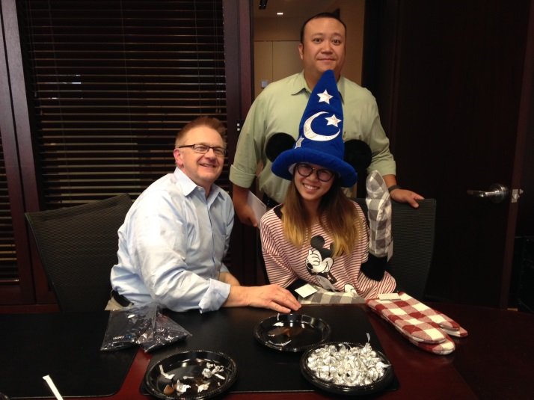
Why Join TMNAS?
We Have FUN!!
Notes:
Tuition Reimbursement, industry designations, certification program, education incentives, and company sponsored programs

Slide 27
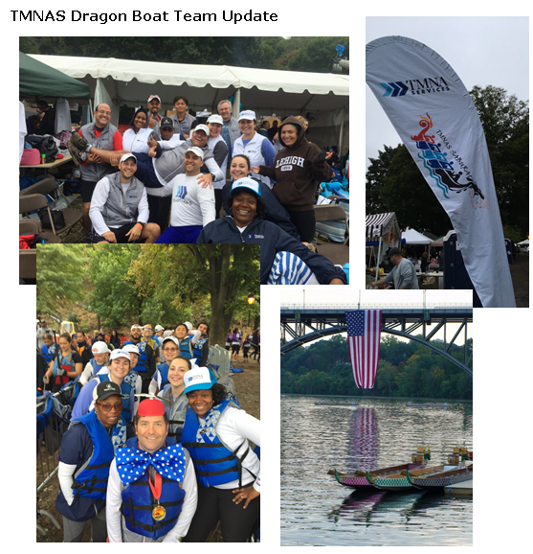
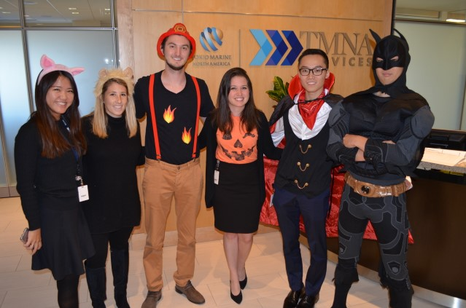
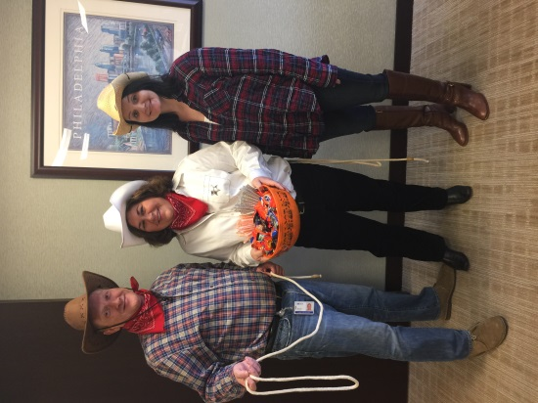
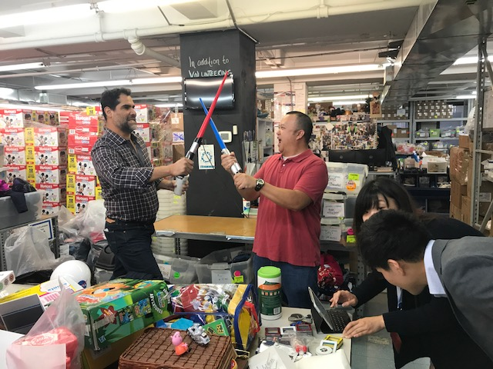
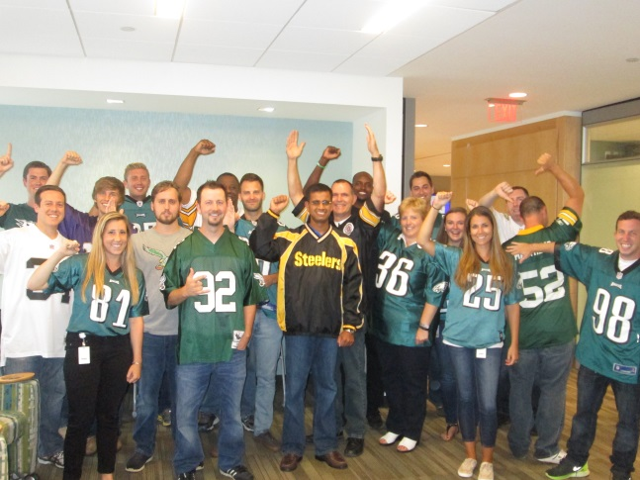
Why Join TMNAS?
We Have FUN!!
Notes:
Employee Engagement
Legal Club
Fitness Center
Run Club
Women In IT
Book Club
Learning & Development
TMNAS promotes professional growth. Employees are encouraged to pursue continuing education opportunities, industry designations, certification programs, and more.
Our education benefits include:
Tuition Reimbursement
Industry Designations
Certification Programs
Education Incentives
Company Sponsored Training Programs

Slide 28
Thank You!

Slide 30


Slide 33
Dragonhacks 2018
Jeff Karper
Manager, Engineering Leadership Development Program
Adrienne McAbee
Campus Recruiter, Lockheed Martin

Slide 34

Lockheed Martin

Slide 35
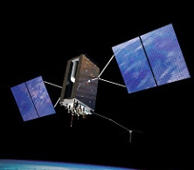
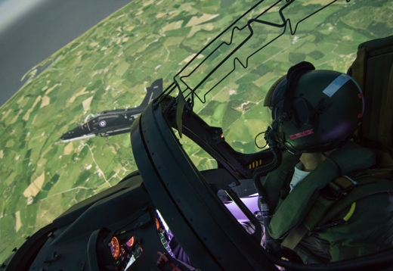

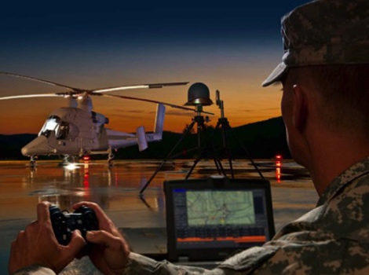


Customers
Departments of
Defense
Homeland Security
Commerce
Energy
State
Transportation
NASA
Intelligence Communities
70 other Governments Worldwide
We Never Forget Who We’re Working For ®

Slide 36
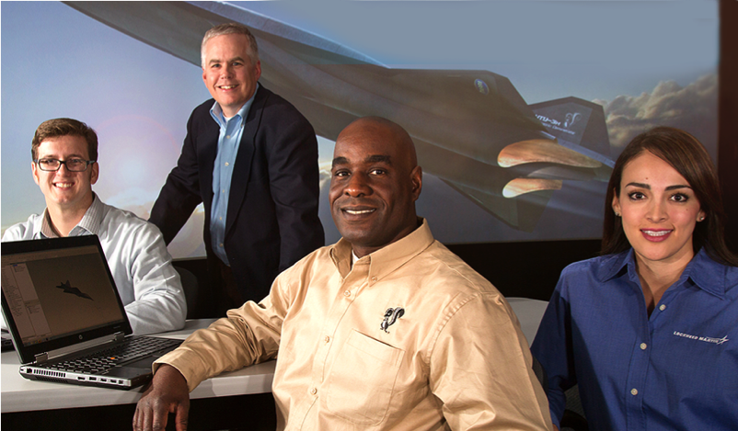

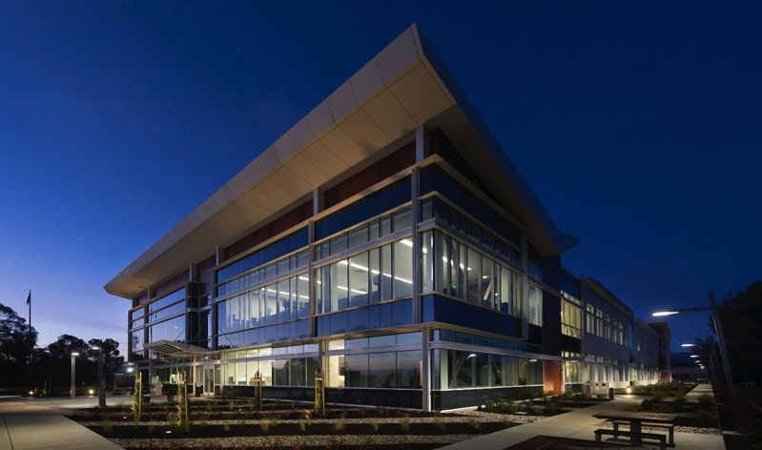

People
49,000
97,000 Employees
Scientists and Engineers
400+ Facilities Worldwide
Operating in over 58 Countries
With 7,100+ Employees

Slide 37
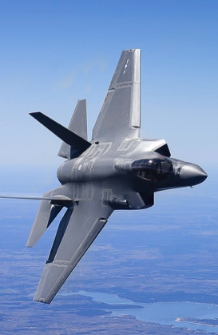
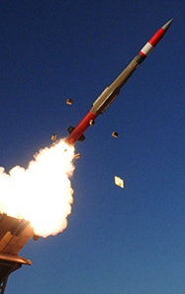

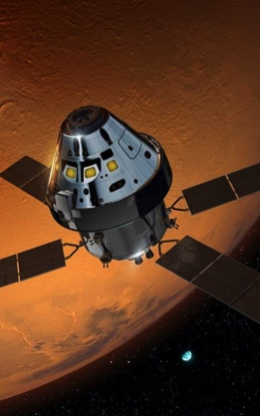
Lockheed Martin Business Areas
Aeronautics
Tactical Fighters
Tactical /Strategic Airlift
Advanced Development
Sustainment Operations
Missiles and Fire Control
Air and Missile Defense
Tactical Missiles
Fire Control
Combat Maneuver Systems
Energy
Rotary and Mission Systems
Maritime Solutions
Radar and Surveillance Systems
Aviation Systems and Rotorcraft Platforms
Training and Logistics Solutions
Space Systems
Surveillance and Navigation
Global Communications
Human and Deep Space Exploration
Strategic and Defensive Systems

Slide 38
Lockheed Martin DragonHacks Challenge
Our customers value clear, concise presentation and visualization of the analysis of complex datasets
Many of our challenges at Lockheed Martin stem from our need to analyze large sets of data, for example:
Performance analysis, system models, simulations, and test results for our Aegis Ballistic Missile Defense System or high-fidelity radar system models
Monte Carlo simulation results for real-world scenarios
Space Fence radar system tracks and projected positions of objects in Low Earth Orbit
Statistical parameters and probability distributions of fabrication process and environmental variance for integrated circuits
Automated test results of tactical systems
Many, many others…
Stop by our booth and talk to our engineers for more information
Lockheed Martin will award a prize to the best team that analyzes a system model or complex data set and demonstrates a superior visualization tool to present the data
Preference will be given to projects that are relevant to Lockheed Martin products, markets, or technologies

Slide 40
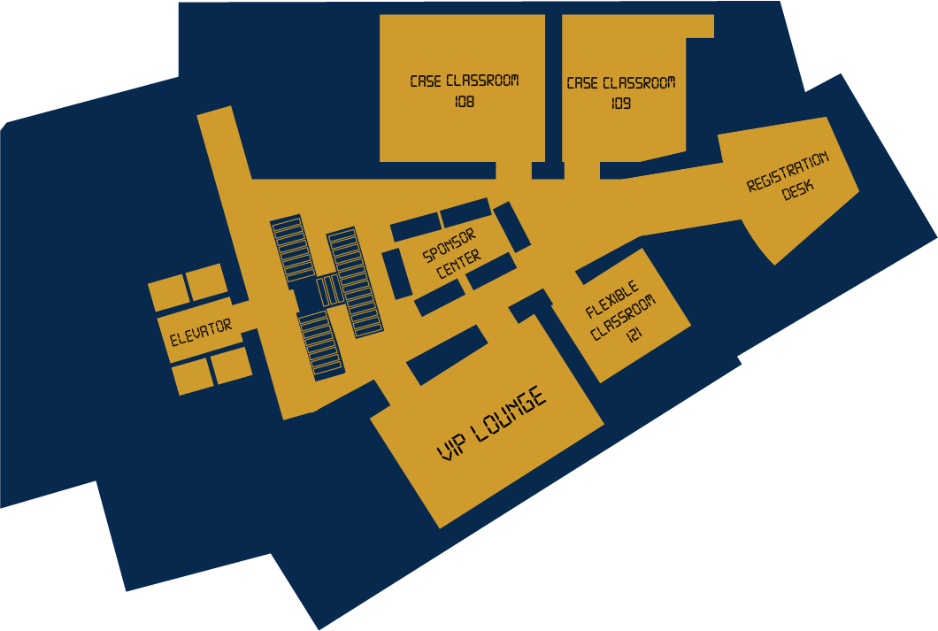
First Floor

Slide 41
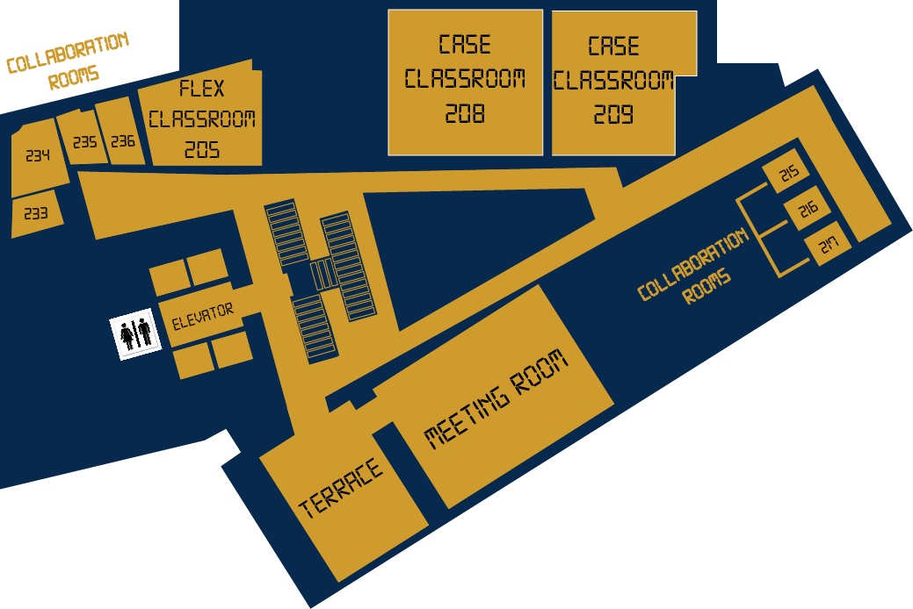
Second Floor

Slide 42

Third Floor

Slide 43
Important Locations
Hacking Spaces | Floors 1 – 3, Classrooms and Collaboration Rooms
Hardware Checkout | Hardware Center – 3rd Floor
Meals and Snacks | Terrace – 2nd Floor
Tech Talks | Meeting Room – 2nd Floor
Tournaments/Activities | Sponsor Center – 1st Floor or Basement
Closing Ceremony | Meeting Room – 2nd Floor

Slide 44
Available Resources
Hardware Checkout | 3rd Floor, List Of Parts On Dragonhacks.Io, Bring Student Or Government ID
Mentors | Sponsor Center, Sponsors Have Brought Some Of Their Technical Talent In Order To Assist You With Your Creations
Volunteers/Organizers | If You Need Help With Anything Or Are Curious About Something, Check In With The People In Purple

Slide 45
Saturday Schedule
2:00 PM | Hacking Commences | Designated areas
 | Hardware Checkout Open | Hardware Center – 3rd Floor
2:30 PM | Tech Talks #1, #2, #3, #4 | Meeting Room– 2nd Floor
6:00 PM | Dinner | Terrace – 2nd Floor
8:00 PM | TOURNAMENT ARC | Sponsor Center– 1st Floor
 |  | Basement

Slide 46
Sunday Schedule
12:00 AM | Netflix and Chill (SFW) | Basement
1:00 AM | Late Night Pizza | Terrace – 2nd Floor
3:00 AM | Still Awake? Snack | Terrace – 2nd Floor
8:00 AM | Breakfast | Terrace – 2nd Floor
12:00 PM | Lunch | Terrace – 2nd Floor
2:00 PM | Submission Deadline | DevPost
2:30 PM | Judging Begins | All Floors
4:00 PM | Closing Ceremony | Meeting Room– 2nd Floor

Slide 47
Promotional Video
https://www.youtube.com/watch?v=dGxsiwx5-uc&feature=youtu.be

Slide 48




How the games work
7 Games, 7 Points, 1 Victor
Each Champion gets a Prize!
Winner Team gets:

Slide 49

Smash!!!!

Slide 50


Mario Kart & 1 – 2 Switch

Slide 51
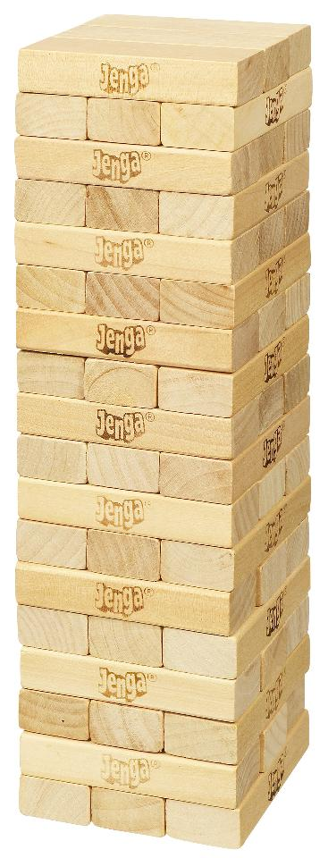

Something More Traditional

Slide 52

MR. Robot Challenge

Slide 53
Project Submission
Sign up on DevPost
Submit relevant materials (video, pictures, code, etc.) of your hack
Don’t forget to include your team members
Deadline is 2pm on Sunday January 6th
No late submissions will be accepted!

Slide 54
General Rules & Notes
Be kind and respectful (to each other and the environment/equipment around you)
Stay in designated areas
If you have any questions or concerns, don’t hesitate to approach one of our volunteers or organizers
Have fun!

Slide 55
Internet Connection
Mobile & Wireless
Connect to the network “drexelguest”
Open up web browser and be redirected to Drexel Guest Welcome Page
Select “Sponsored User” link and input credentials
Username: dragonhacks
Password: cold2018
Alternatively, connect to “dragonflyguest”, open up web-browser, and sign in with your email

Slide 56
Keeping Updated
Get the latest info on tech talks, minigames, events & other news by following us on:
Twitter: DragonHacksIEEE
Facebook: DragonHacksIEEE
Instagram: DragonHacksIEEE
Snapchat: DragonHacksIEEE
Slack: dragonhacks2018 (https://goo.gl/ZStXpt)
DevPost: #DragonHacks #MLH

Slide 57
Happy hacking!!!

